Slide 1


Research on Antimicrobial Resistance
linked to China
Herman Goossens
Professor in Medical Microbiology
Vaccine & Infectious Disease Institute
University Antwerp, Belgium

Slide 2
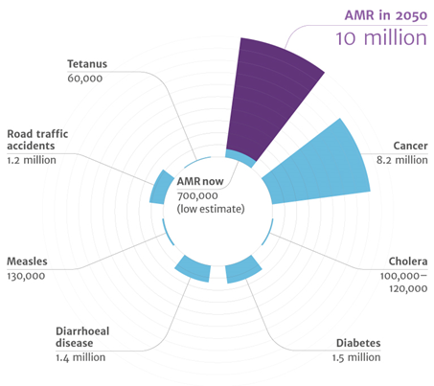
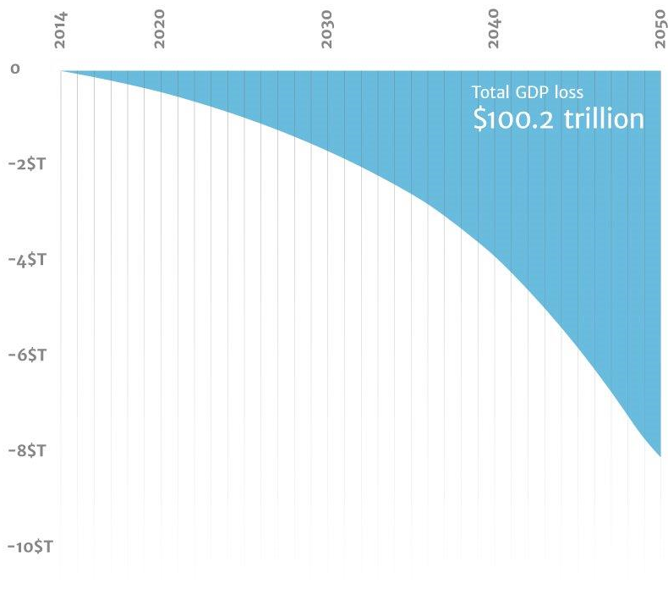
The Global Health threat of AMR

Slide 3
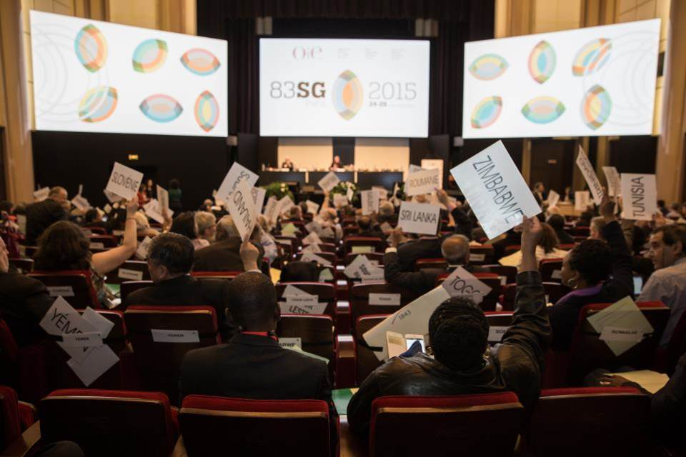
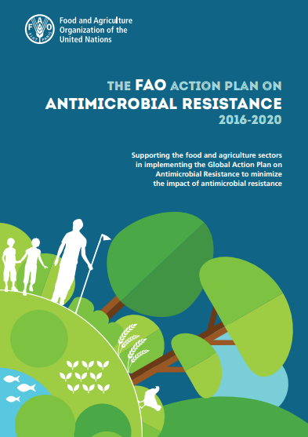

AMR high on political agenda
  83rd World Assembly of the OIE Delegates (May 2015)
  Adoption of the Resolution No. 26 on AMR

Slide 4
Initiatives of G7 and G20 in 2017
G20 Meeting Health Ministers in Berlin (May 19-20)
G7 Meeting in Taormina, Italy (May 26-27)
G20 Meeting in Hamburg (July 7-8)
  Proposed healthcare issues by German government:
    Using the potential of information and communications technology
    Improving the use of antibotics
    Fighting Neglected Tropical Diseases / Pandemics
    Mental health – overcoming the taboo of mental health

Slide 5
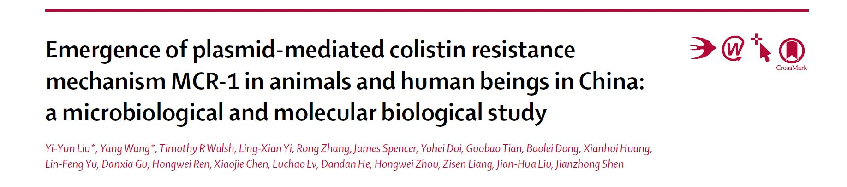
MCR-1 (mediated colistin resistance)
Lancet Infectious Diseases 2015

Slide 6
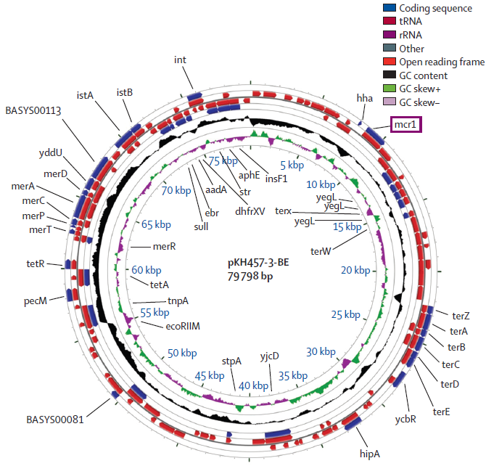
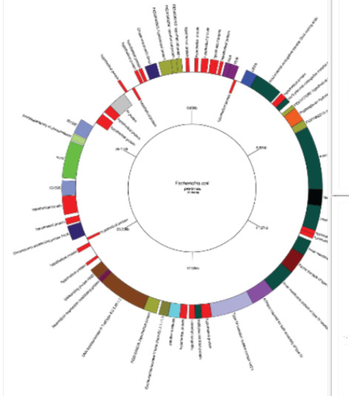
The rising problem of AMR and introduction of ‘old’ antibiotics: colistin
Malhotra Kumar et al, Lancet Infect. Dis 2016
Xavier et al. Euro Surveill. 2016;21(27)
Emergence of plasmid-mediated colistin resistance in animal farms in Belgium and Vietnam
Identification of a novel plasmid mediated gene mcr-2 conferring colistin resistance
Notes:
Mechanisms of antibiotic resistance in pathogenic bacteria: The main focus is on investigating 'old' antibiotics that have been reintroduced into clinical practice and whose resistance mechanisms are not yet known such as colistin, nitrofurantoin and fosfomycin. Both clinical, patient derived strains as well as in vitro passaged strains undergo strain typing, whole genome sequencing, resistance stability studies and fitness cost assessments to understand emergence of the resistance mechanisms as well as their fate in the community.

Slide 7
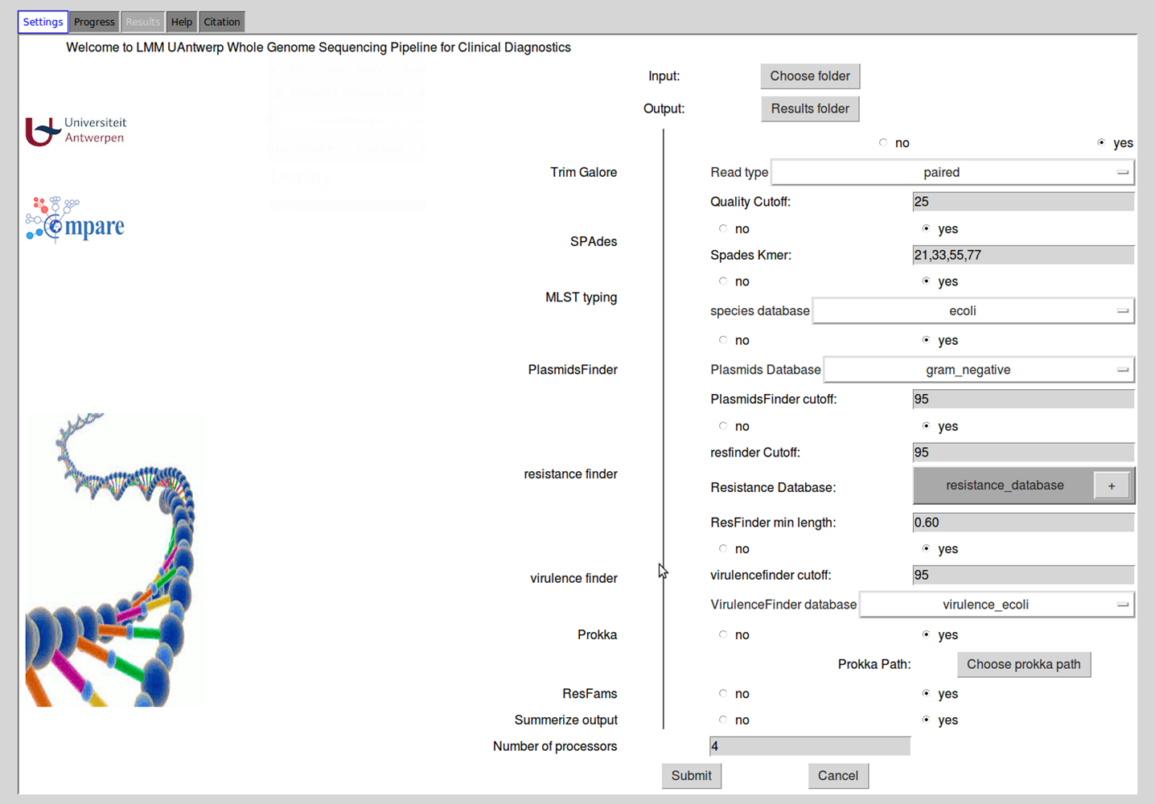
Next Generation Sequencing Analysis Pipeline for Clinical Diagnostics

Slide 8

Global-PPS of Antimicrobial Consumption and Resistance in 2015 in 53 countries in 335 Hospitals Worldwide
Coordinator: Herman Goossens
Laboratory of Medical Microbiology
University of Antwerp

Slide 9
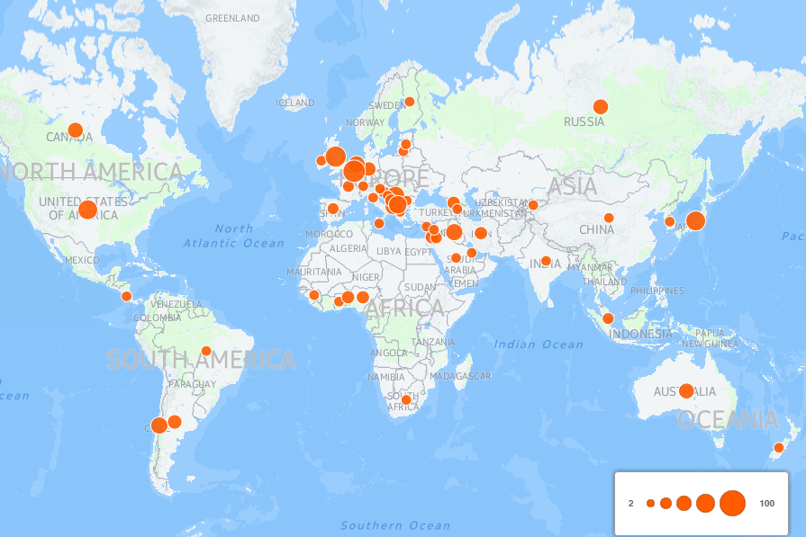
Global-PPS 2015; Degree of participation
2C;22H
24C;213H
16C;57H
5C;12H
4C;22H
2C;9H
N = 53 C (countries)
N = 335 H (hospitals)

Slide 10
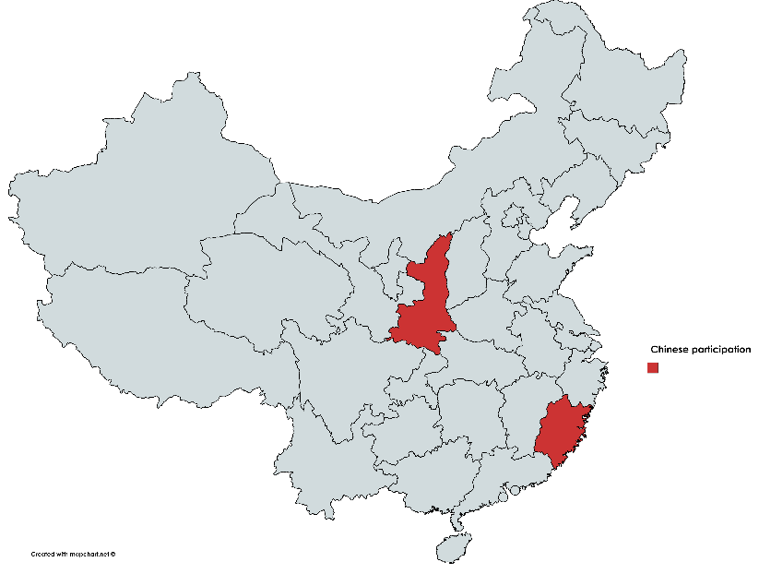


Chinese participation to the 2017 Global-PPS
Shaanxi (Xi’An + Yanan) : 6 hospitals, among which 1 participated to the 2015 Global-PPS
Fujian: 1 hospital
Notes:
7 hospitals are participating to the 2017 G-PPS; 6 from the province Shaanxi and 1 from the province Fujian

Slide 11
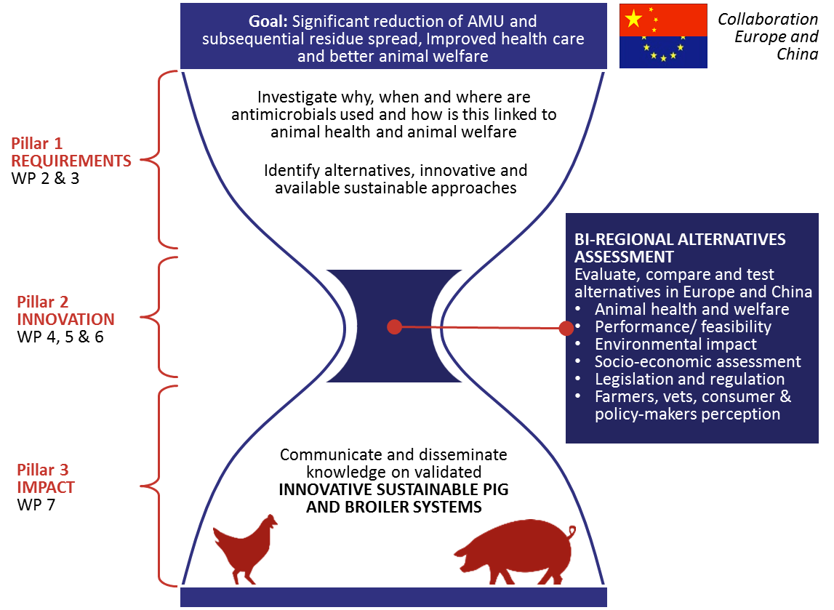
Developing and combining innovative animal health care solutions for reduced antimicrobial use and improved animal welfare tailored to pig and broiler production in Europe and China:
Coordinators: Prof. Dewulf (UGent) and Prof. Yang (CAU)
Figure 2. The INCARNA concept for research and innovation

Slide 12
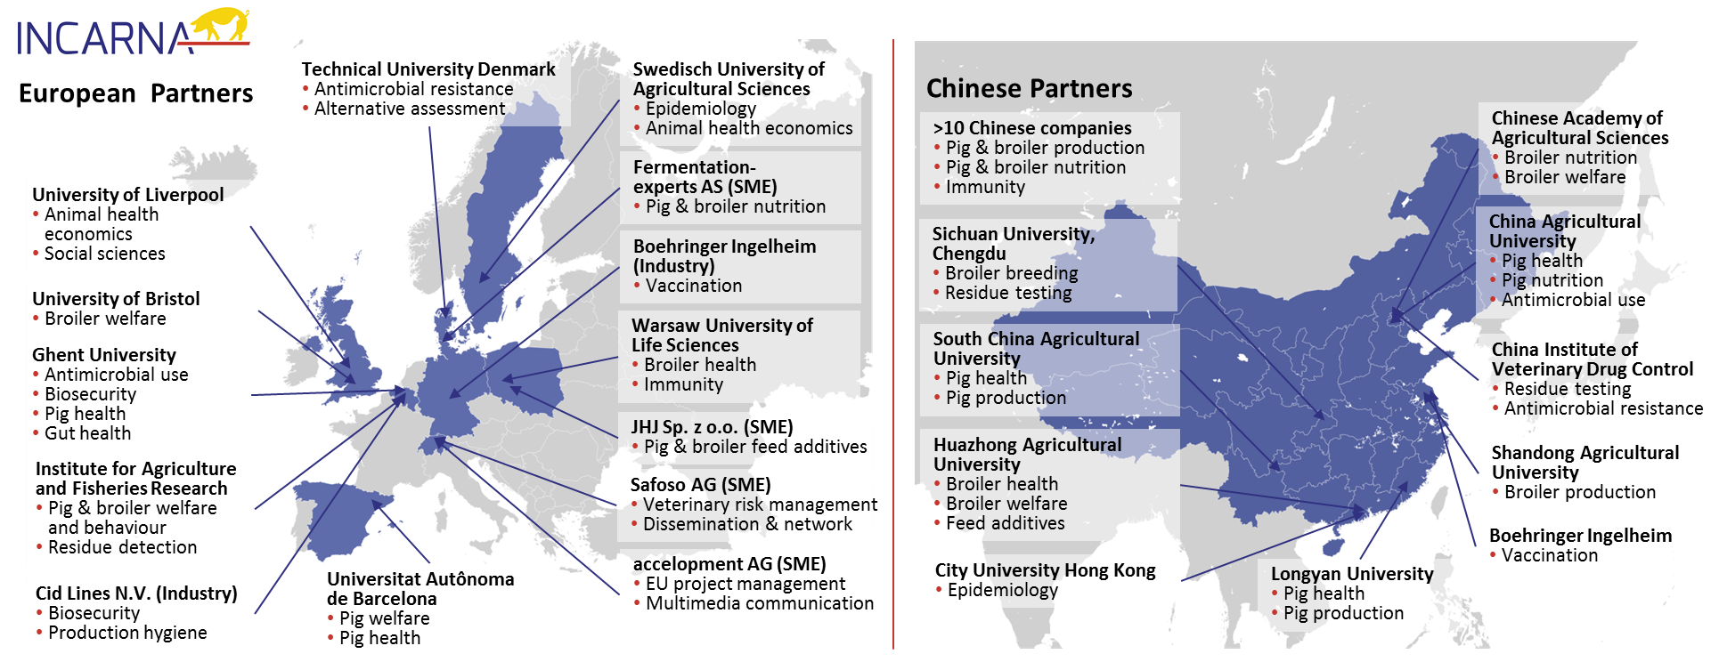
INCARNA Partners in the EU and China

Slide 13

Kobé Communiqué
“we encourage governments to consider the need for establishing a global clinical studies network on drug resistance that provides access to a large clinical research infrastructure for the design, coordination and conducting of clinical trials and studies in cooperation with the existing global experts networks to ensure the common benefit of the outcomes”
G7 Health Ministers’ Meeting
11-12 September 2016
Shiozaki et al. Lancet. 2016;388 (10051):1262-3

Slide 14
Clinical studies in Europe with
Global (China) link

Slide 15



European Clinical Research Alliance on Infectious Diseases (ECRAID): The Science of Clinical Trials
Hospital sites
Laboratory sites
GP sites
Statistics
expert sites
Pediatric sites
Epi-research expert sites

Slide 16
Back up slides

Slide 17
Laboratory of Medical Microbiology at the University of Antwerp
Translational research
In vitro/vivo models of biofilm formation
Animal models of infection
Whole genome sequencing, optical mapping and metagenomics approaches
Bio-imaging (fluorescence and confocal microscopy
Transcriptomics, proteomics and lipidomics
Antimicrobial use
Clinical trials

Slide 18
To develop a sustainable platform between Belgium and China that will facilitate a constant dialogue on addressing common health R&I challenges.
To identify health challenges, commonly shared, whose solution may benefit from close cooperation between Belgium and China
Proposed actions

